Slide 1

Homework
Open a new Excel sheet
Enter data in the cells, change font style, font size-14, text colour
Add border
Save your project as “Homework-1”.

Slide 2
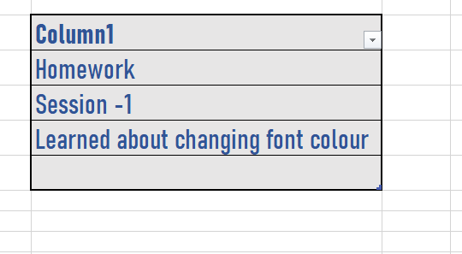
Homework Solution

Slide 3






Excel
Session - 2

Slide 4

Entering Data
Entering Text, applying font style, font size
Wrapping Text
Formatting data in Table
Selecting cell style
Clearing Data

Slide 5
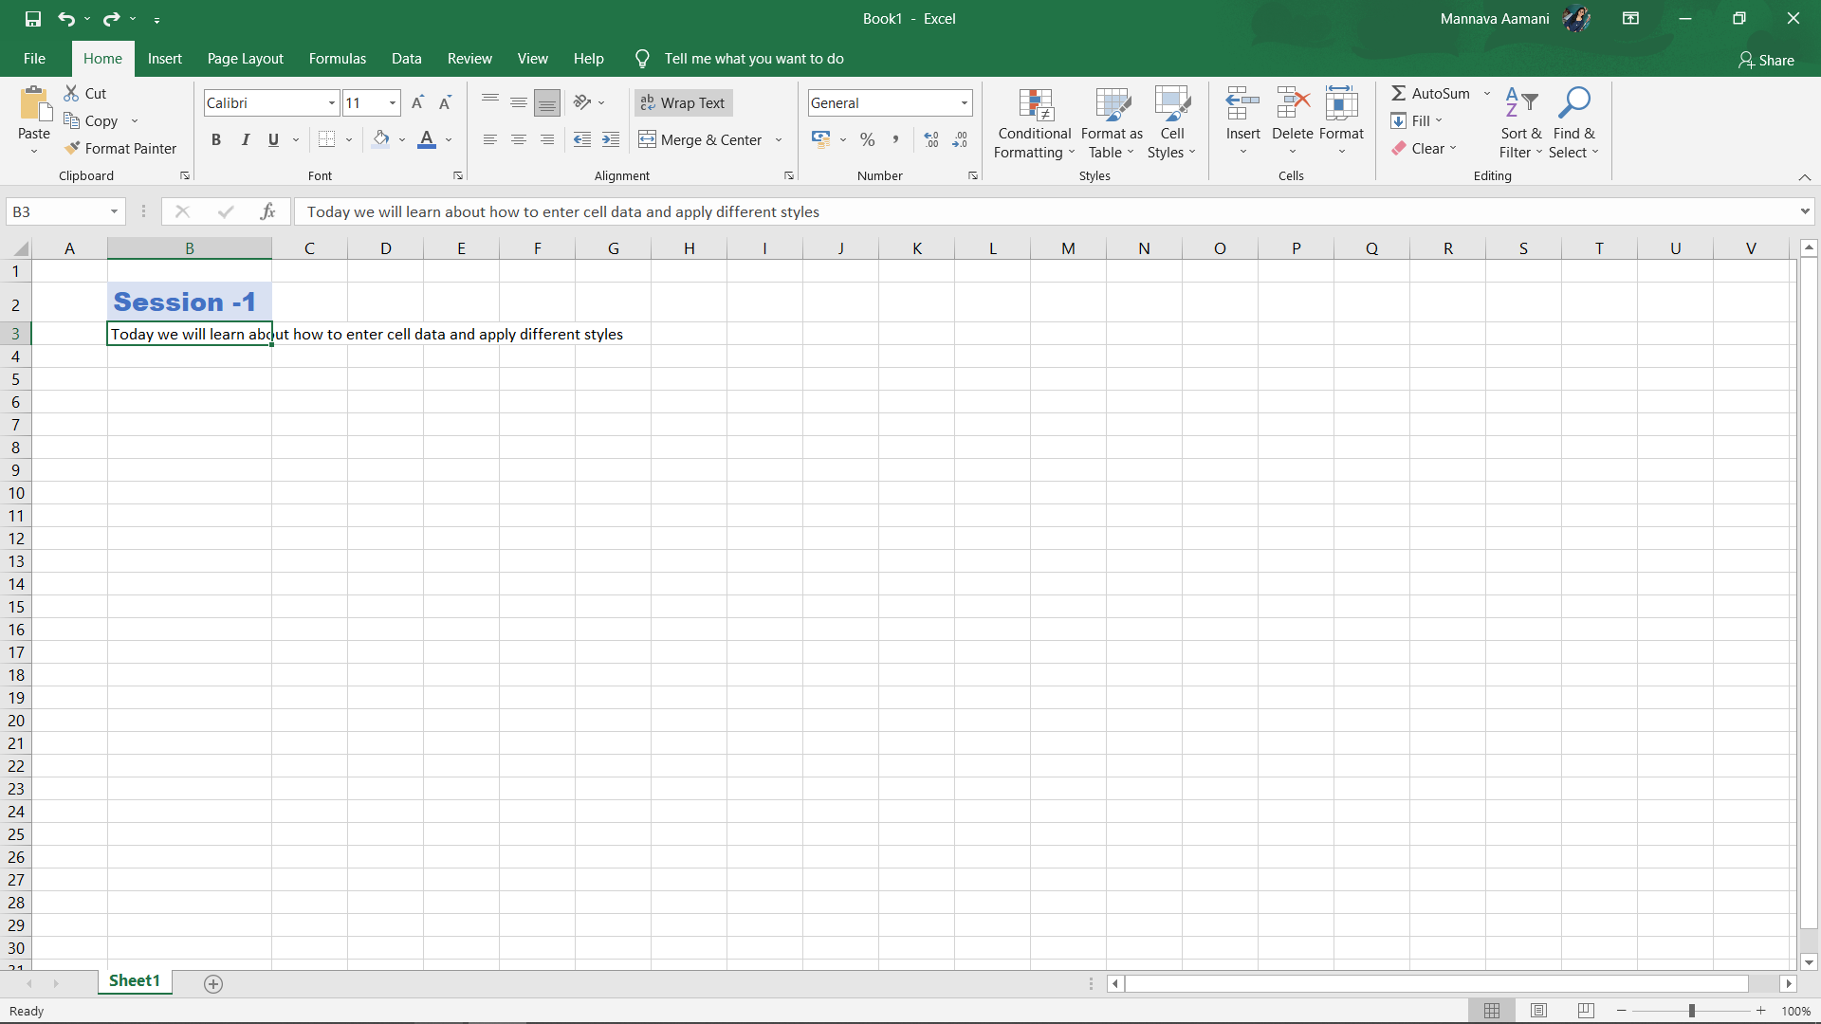
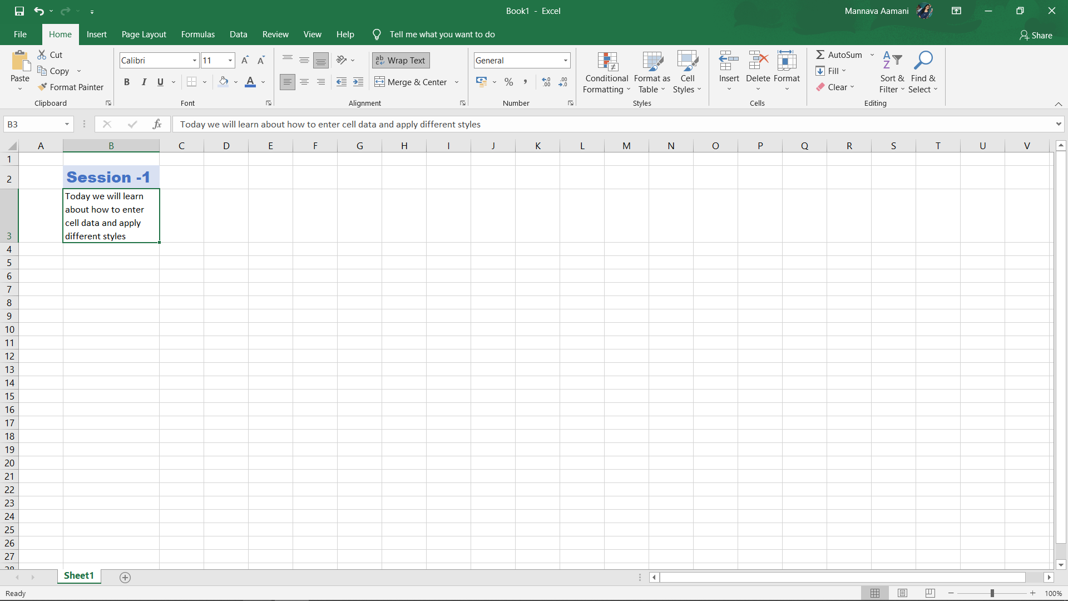
Wrapping text

Slide 6
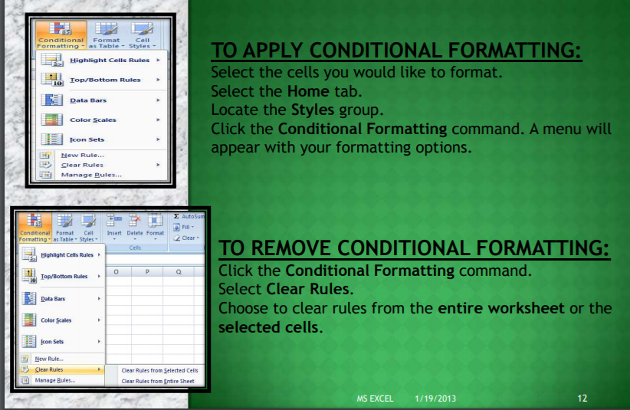

Conditional formatting

Slide 7
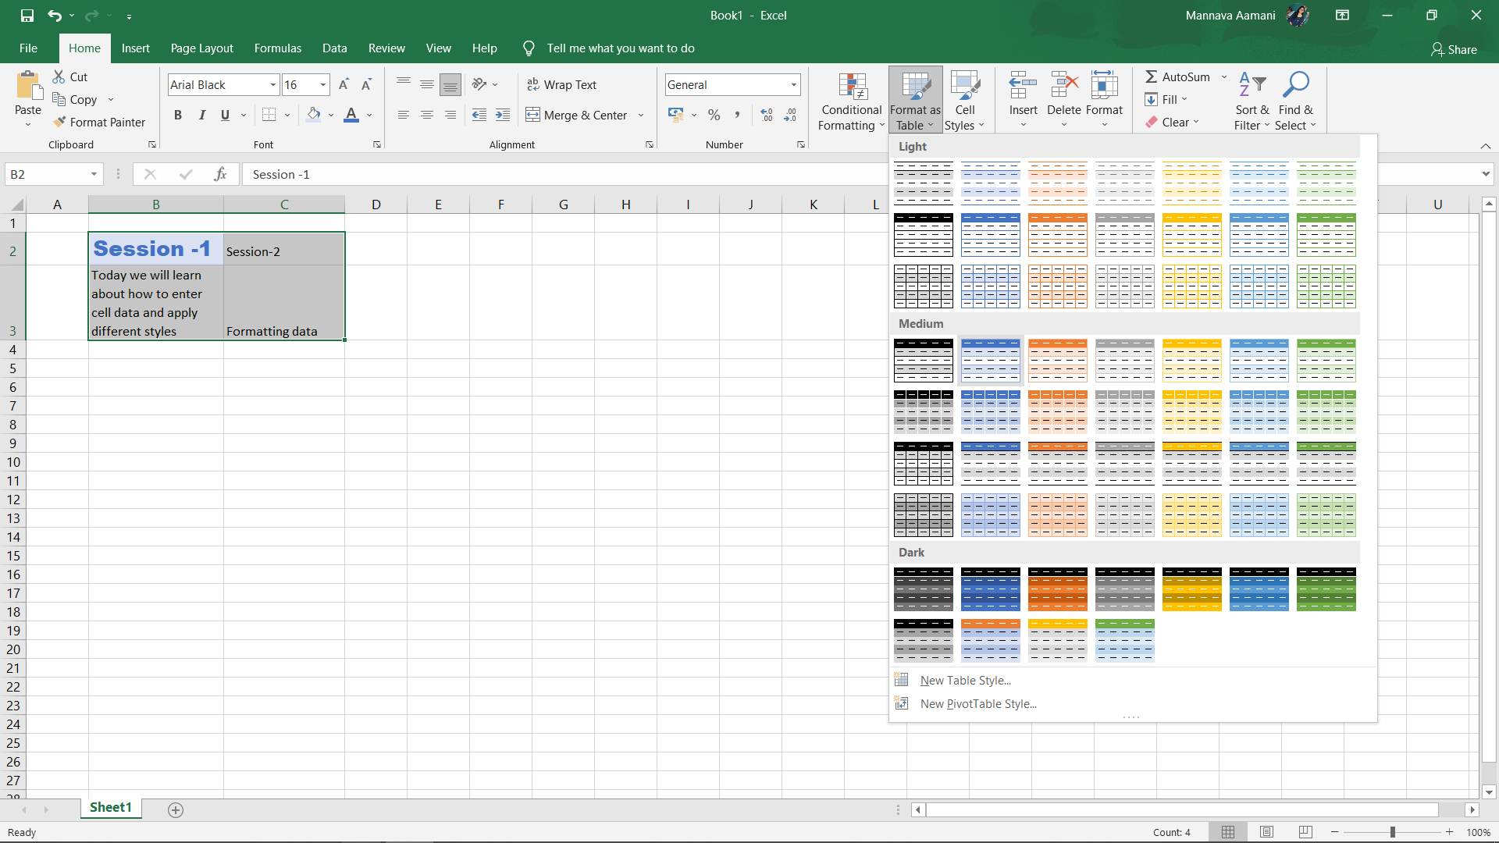
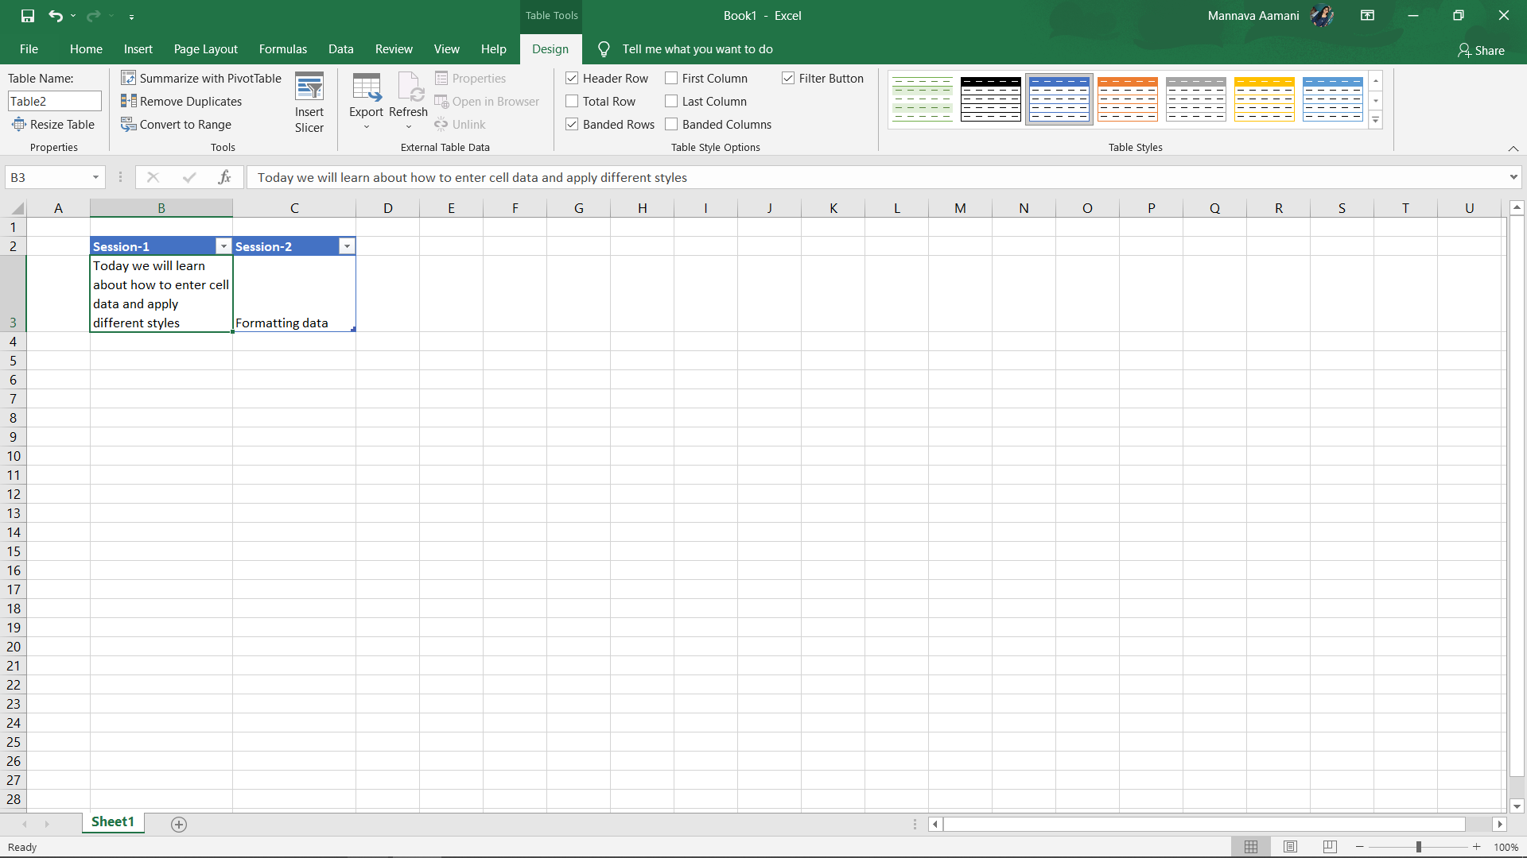
Formatting data in table

Slide 8
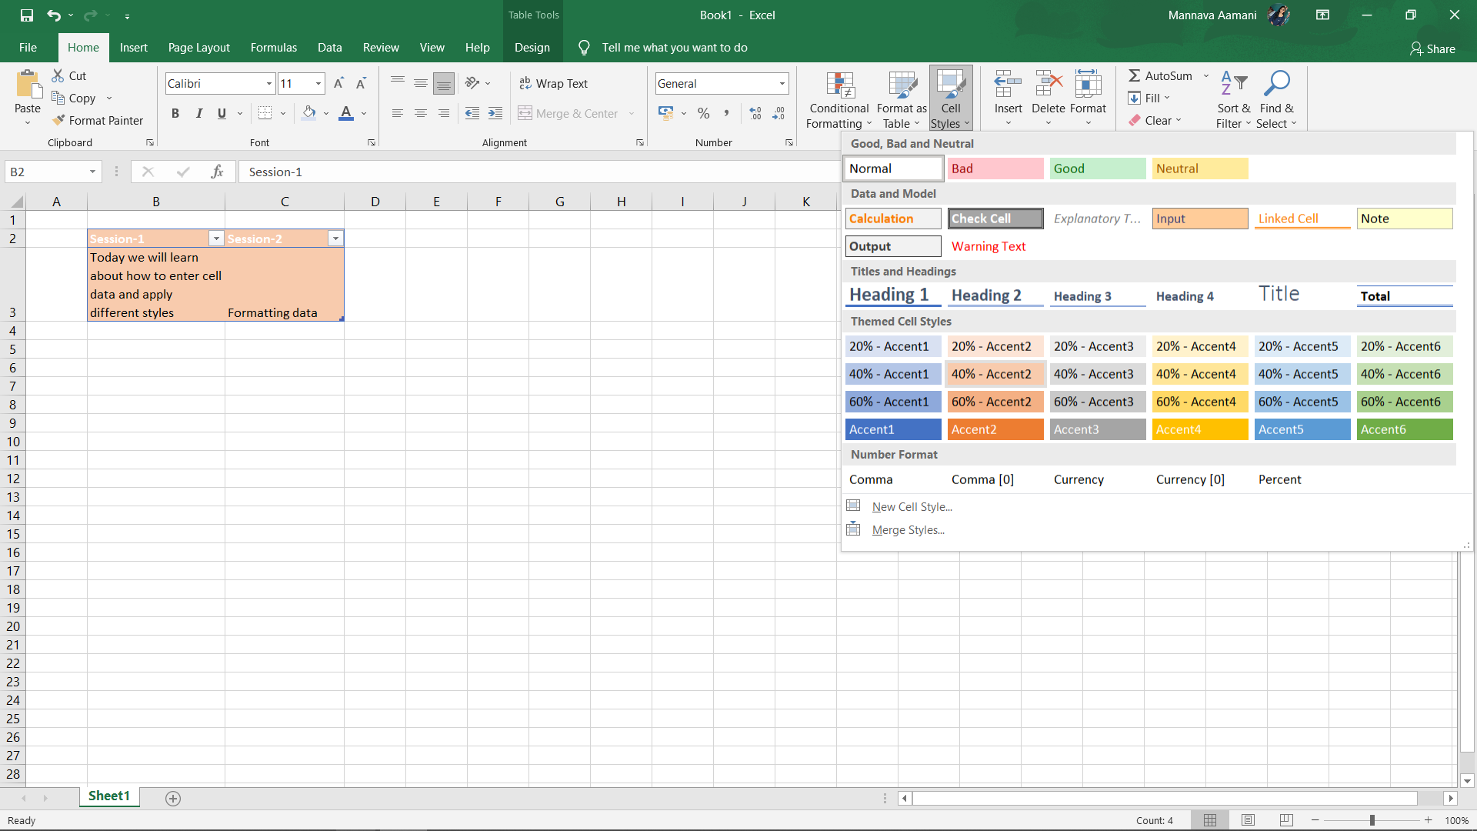
Selecting cell style

Slide 9
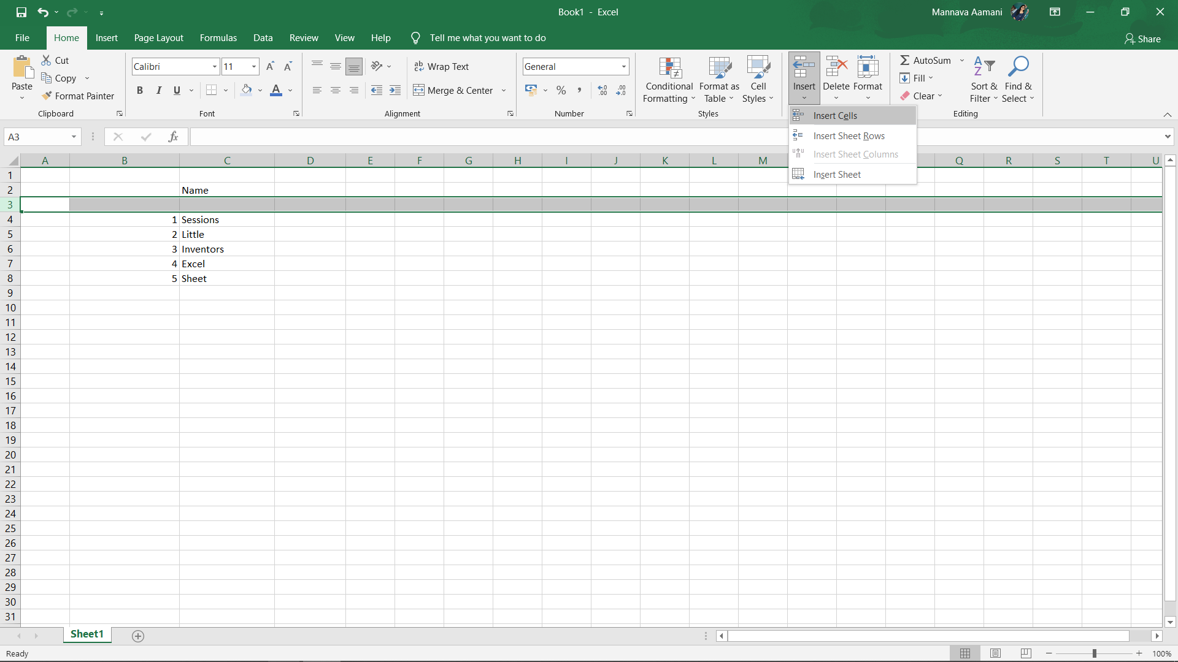
Insert new row and new column

Slide 10
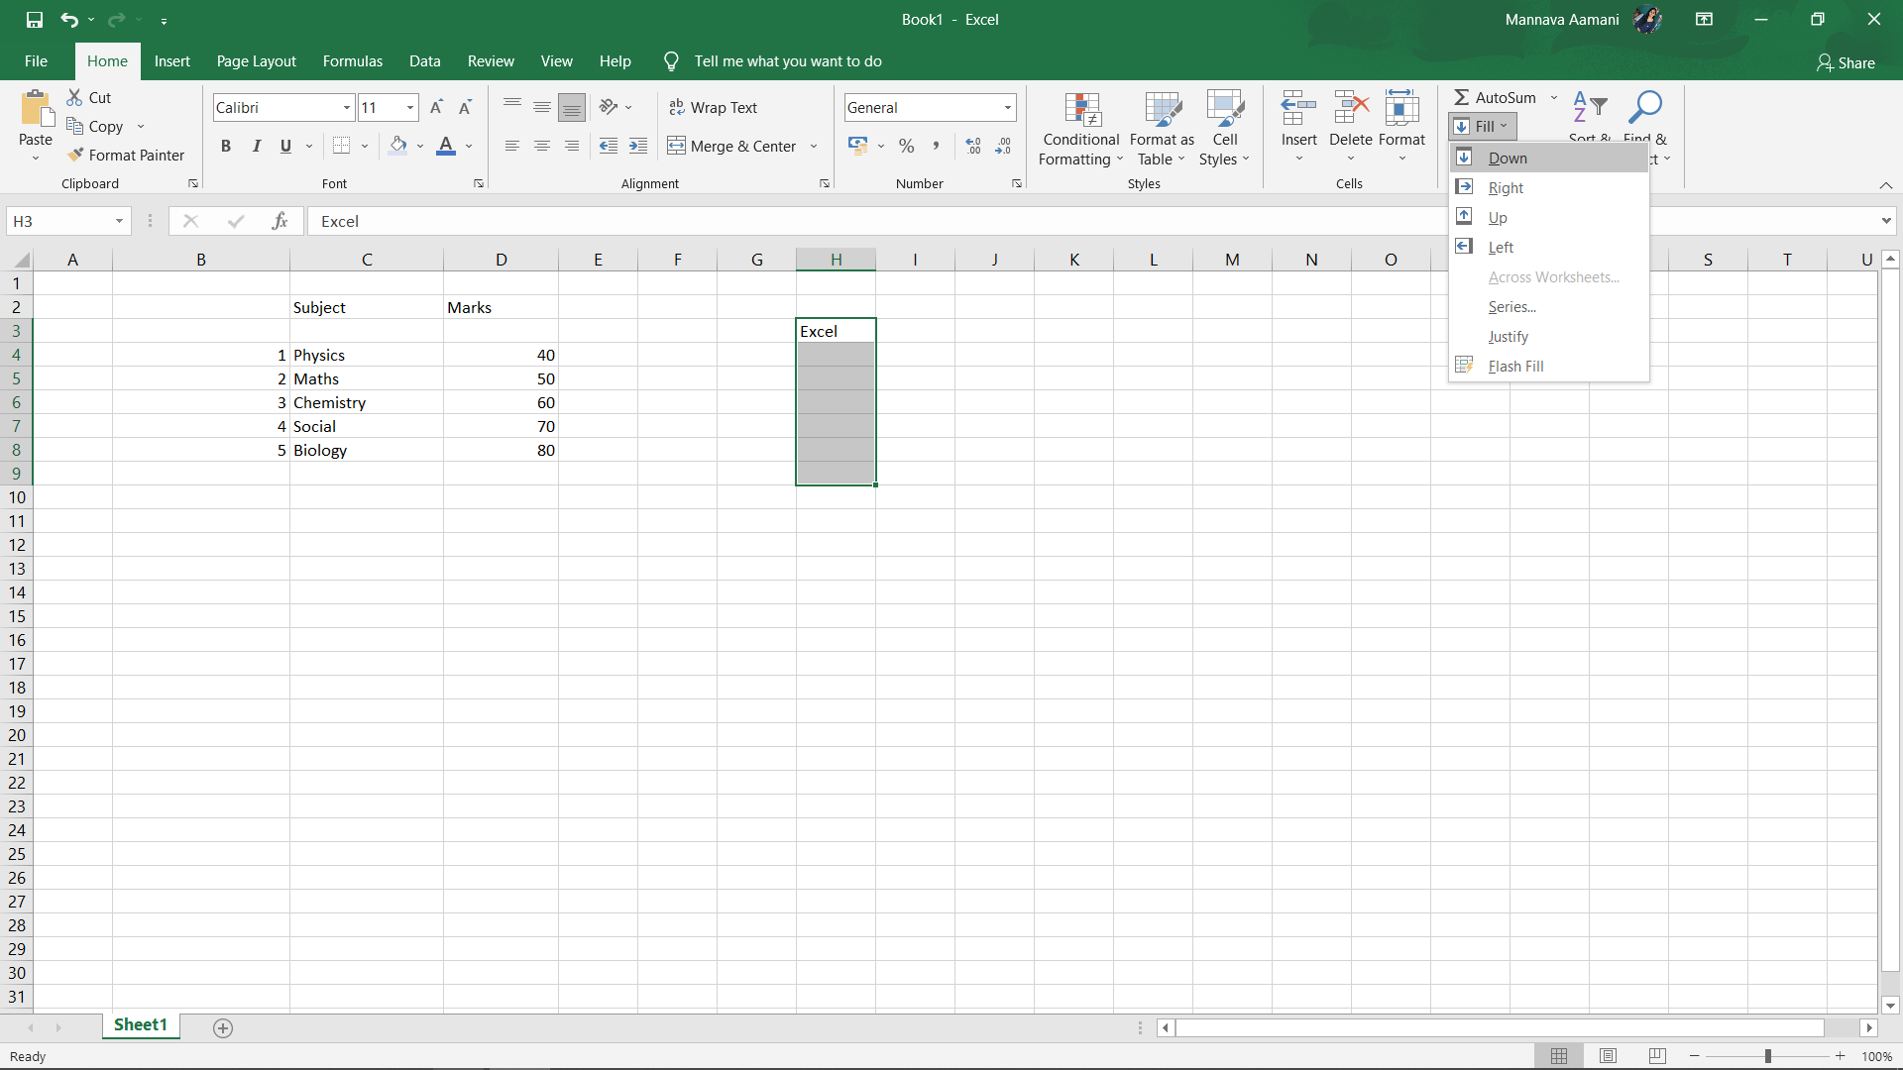
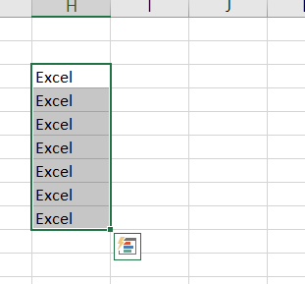
If we want the same data, Use fill

Slide 11
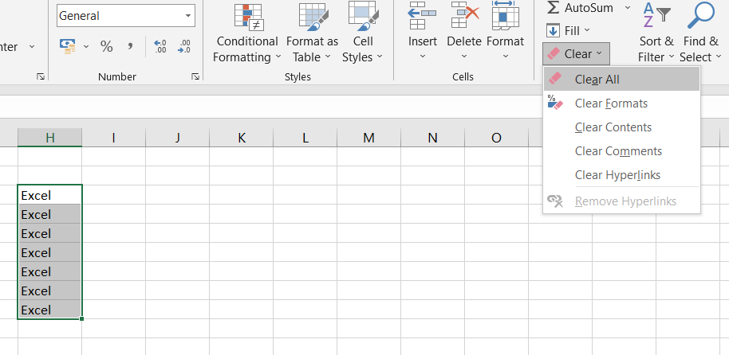
Clear option - Clear all data from cells

Slide 12

Task
Open a new Excel sheet
Enter data in the cells, change font style, font size-14, text colour
Apply cell style and format data
Save your project as “Project-2”.
Check whether by using “clear”, you can erase all data.

Slide 13
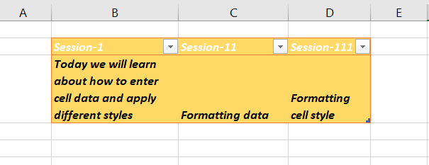
Solution

Slide 14

Homework
Open a new Excel sheet
Enter data in the cells, change font style, font size-14, text colour.
Apply cell style and format data.
Save your project as “Homework on cell formatting”.

Slide 15

ANY QUESTIONS ???

Slide 16



THANK YOU !
contact@littleinventors.in 0091-8368822963 www.littleinventors.in

